Slide 1

Git-GitHub

Slide 2
Objectives
Explain versioning, branching and why they’re vital to the software development process.
Create, edit. and upload new files in GitHub.
Use GitHub to create a branch, commit changes, and initiate a pull request.
Git-GitHub

Slide 3
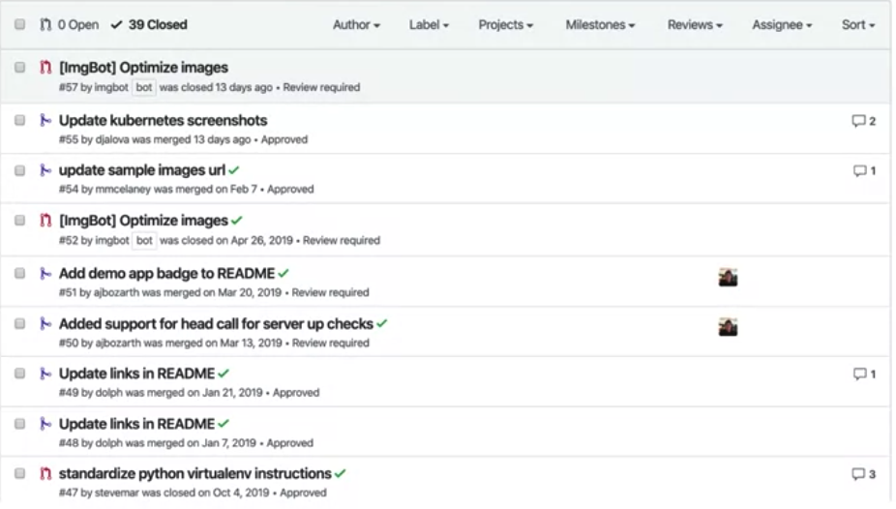
OverView
Git and GitHub are popular environments for performing version control of source code files and projects and collaborating with others.
A version control system allows you to keep track of changes to your documents. This makes it easy for you to recover older versions of your document if you make a mistake, and it makes collaboration with others much easier.
Git-GitHub

Slide 4

Overview Git
Git is free and open source software distributed under the GNU General Public License.
Git is a distributed version control system
Users anywhere in the world can have a copy of your project on their own computer; when they’ve made changes, they can sync their version to a remote server to share it with you.
The most common version control systems available.
Version control code, but you can also version control images, documents, and any number of file types.
Git-GitHub

Slide 5

Overview
GitHub is one of the most popular web-hosted services for Git repositories.
Others include GitLab, BitBucket, and Beanstalk.
Git-GitHub

Slide 6
SHORT Glossary of Terms
SSH protocol is a method for secure remote login from one computer to another.
Repository contains your project folders that are set up for version control.
Fork is a copy of a repository.
Pull request is the way you request that someone reviews and approves your changes before they become final.
Working directory contains the files and subdirectories on your computer that are associated with a Git repository.
Git-GitHub

Slide 7
Basic Git commands
"git init”: cloning an existing repository
"git add" moves changes from the working directory to the staging area.
"git status" allows you to see the state of your working directory and the staged snapshot of your changes.
"git commit" takes your staged snapshot of changes and commits them to the project.
"git reset" undoes changes that you’ve made to the files in your working directory.
Git-GitHub

Slide 8
Basic Git commands
"git log" enables you to browse previous changes to a project.
"git branch" lets you create an isolated environment within your repository to make changes.
"git checkout" lets you see and change existing branches.
"git merge" lets you put everything back together again
Git-GitHub

Slide 9
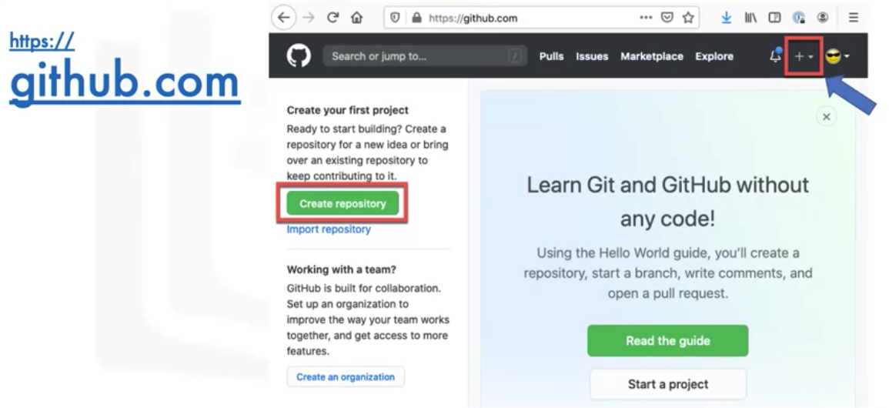
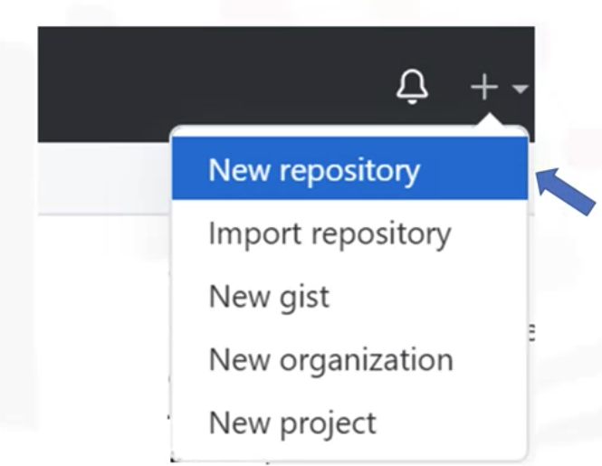
Create a new repository
Git-GitHub

Slide 10
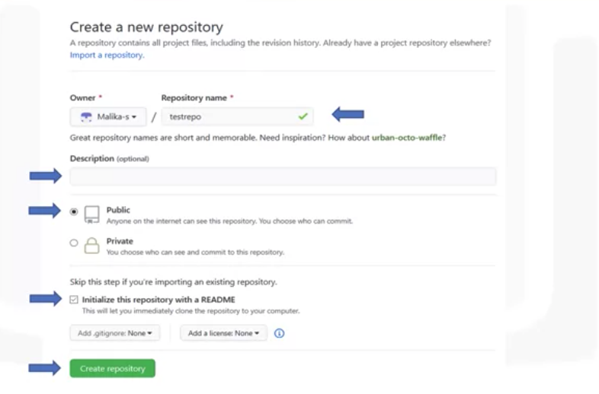
Providing the detail
Git-GitHub

Slide 11
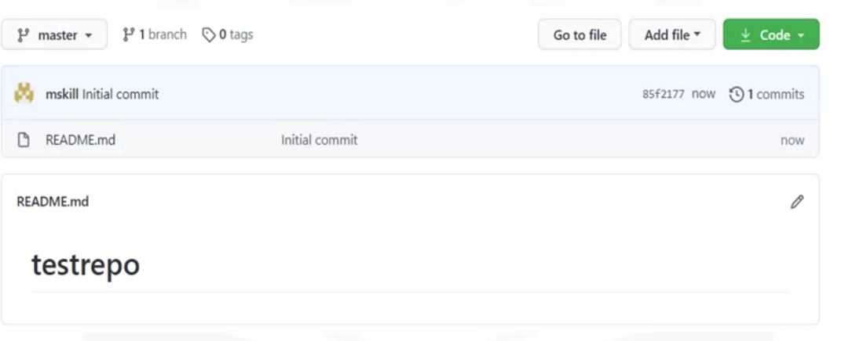
Repository created
Git-GitHub

Slide 12
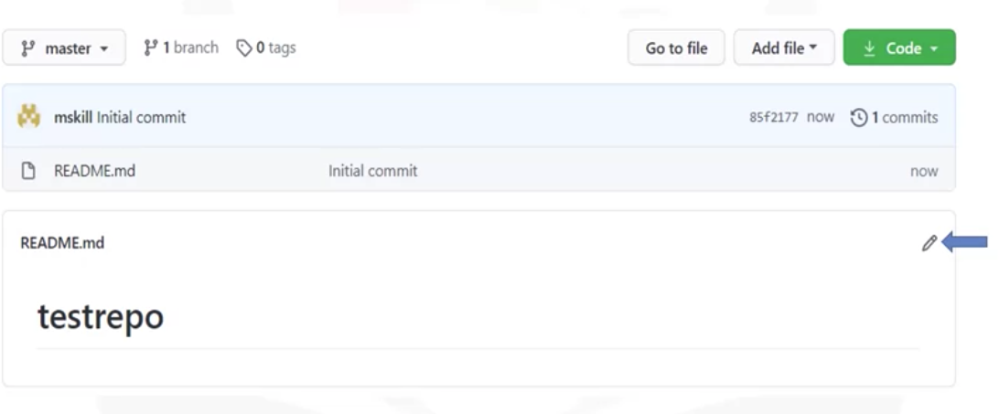
Editing a file in the repository
Git-GitHub

Slide 13
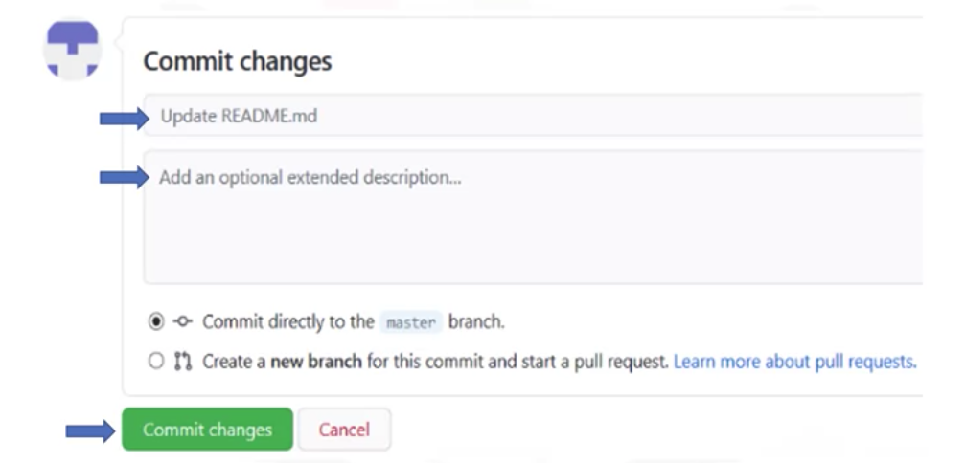
Commit changes
Git-GitHub

Slide 14
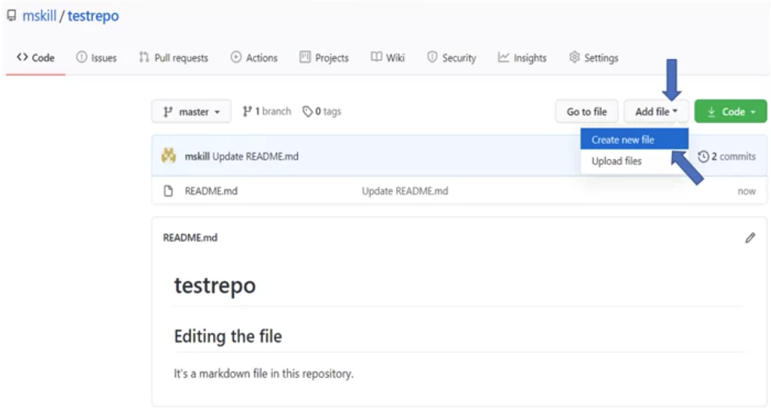
Create a new file
Git-GitHub

Slide 15
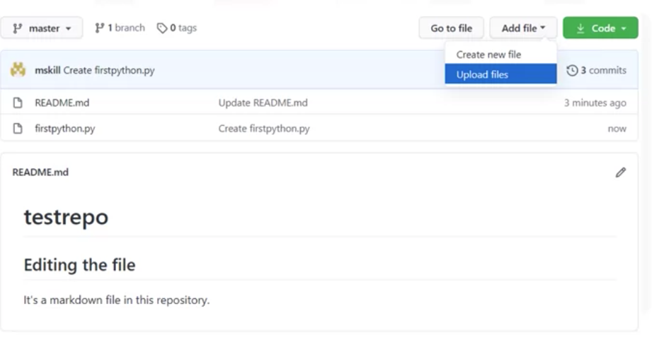
Uploading a file
Git-GitHub

Slide 16
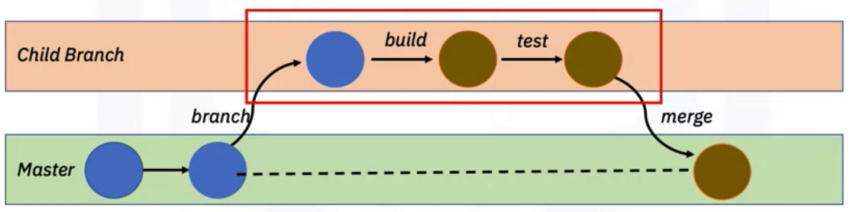
Creating a Branch
A branch is a snapshot of your repository to which you can make changes
The main branch which is called Master, is the one with deployable code and the official working version of your project.
Edits and changes are made in the child branch
Tests are done to ensure quality before merging to the master branch
Git-GitHub

Slide 17
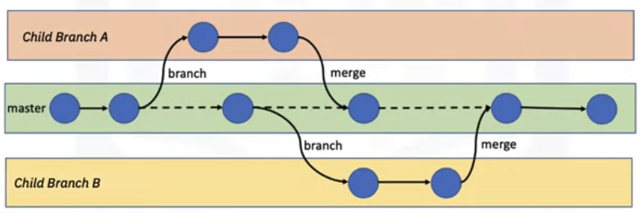
Creating a branch
Branches allow for simultaneous development and testing by multiple team members
Git-GitHub

Slide 18
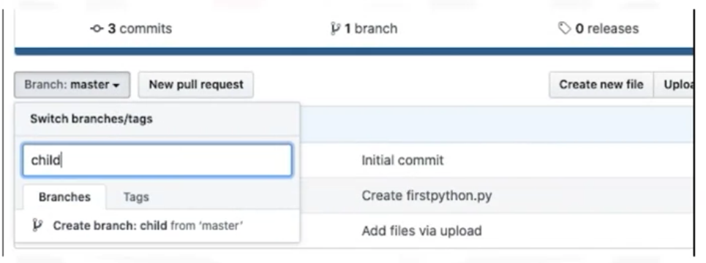

Create a Branch
After create a branch you can add new file, update, edit … but No change in master branch
Git-GitHub

Slide 19
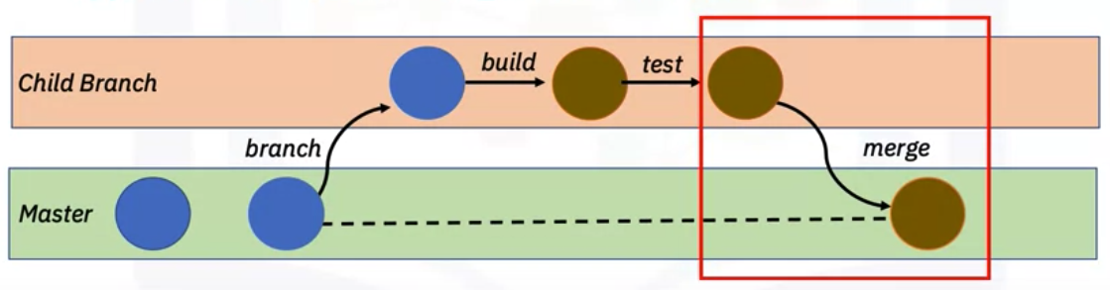
Pull Request
We then want to merge the changes in the child branch to reflect in the master branch.
To merge the changes, we will first have to create a pull request, also known as a PR.
A pull request in simple terms is a way to notify other team members of your changes and edits and ask them for review so they can be pulled or merged into the master branch.
Git-GitHub

Slide 20
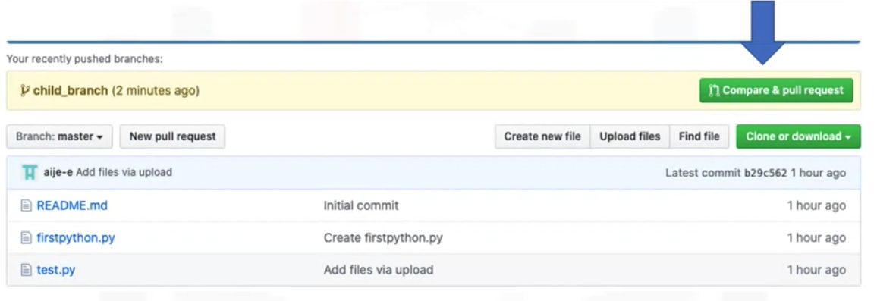
Open a pull request
Git-GitHub

Slide 21
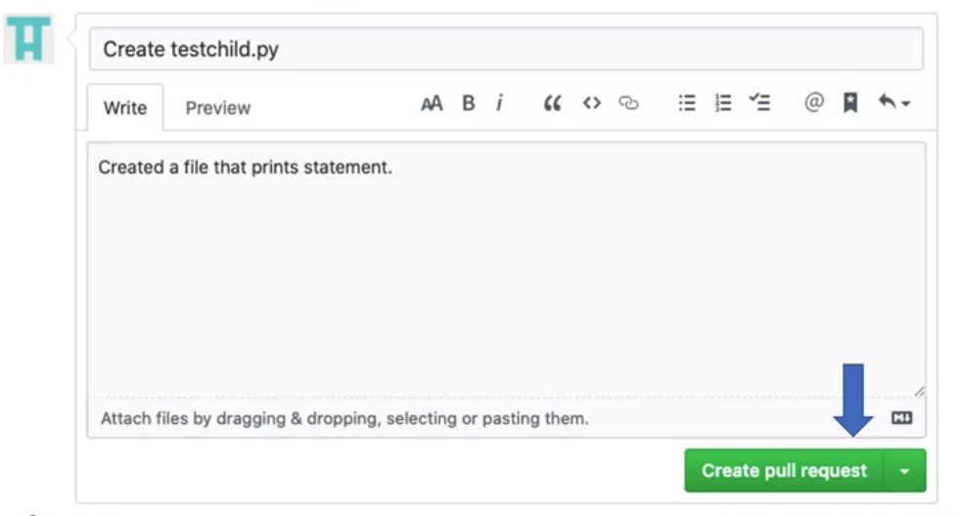
Create a pull request
Git-GitHub

Slide 22
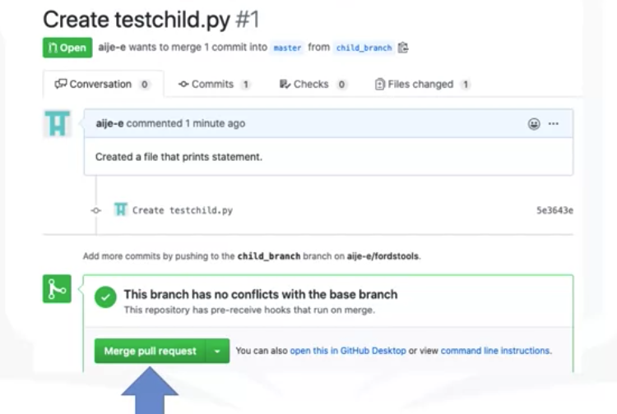
Merge pull request to Master
Git-GitHub

Slide 23
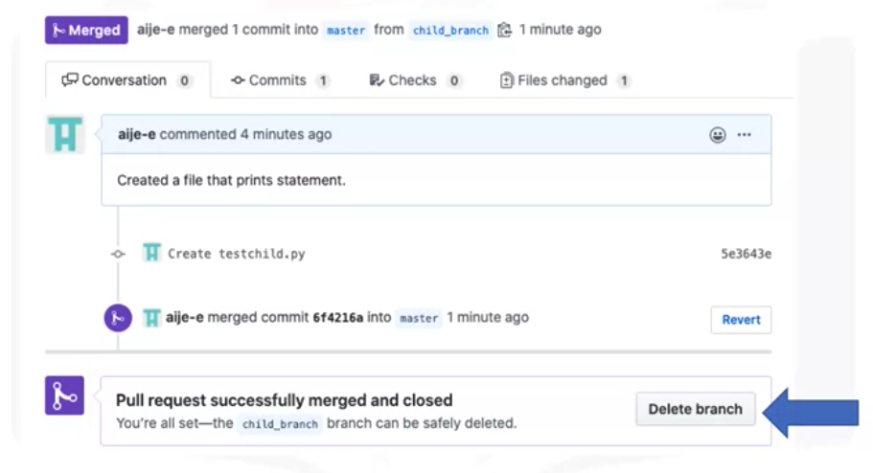
Merge is successful
Git-GitHub

Slide 24
Summary
Explain versioning, branching and why they’re vital to the software development process.
Create, edit. and upload new files in GitHub.
Use GitHub to create a branch, commit changes, and initiate a pull request.
Git-GitHub

Slide 25
Q & A
Git-GitHub

